Slide 1

Digital ID Card
T&I Functions Q2 Hackathon
Team CodeBridge

Slide 2
Introduction
Access to SCB premises at present is controlled manually via physical ID card, consuming significant plastic, paper and other resources
New brand refresh with the new logo has created the need for refreshed ID cards for employees and visitors
Our bank’s core value of ‘Do the Right Thing’ envisages an alternate approach to the environmental impact of plastic
A digital approach with high security features will ensure that physical ID card verification is not needed
In addition to the benefits of carbon footprint reduction we are looking at improving upon operational overheads while setting up/migrating office premises

Slide 3















Solution Architecture
PSHR
APIs
APIs
Authentication
Employee
Employee App
Scanner App
SCB Active Directory
Auth Module
QR Module
Scan Module
Verification Module
Custom Authentication
Visitor
Display Module
Display Module
Cloud Hosted
Firestore Asynchronous NOSQL DB for high performance
Firebase cloud hosted storage
API based data and metadata access
Other features
Verification module based on 30 sec auto secret key change
SHA 256 encrypted authentication
MVC architecture for plug and play into any environment

Slide 4
Features
Uses Firebase db - real time scalable, asynchronous NOSQL based db
Multiple login options - Login via SCB bank ID’s / Google sign in
Enhanced security against tailgating by dynamic QR code generation
Entry log at individual user level

Slide 5
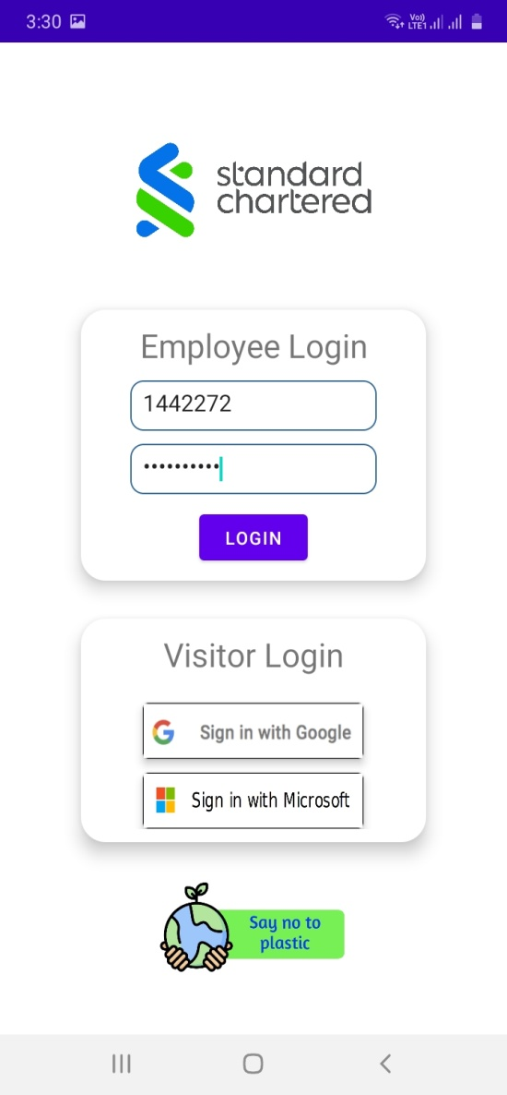
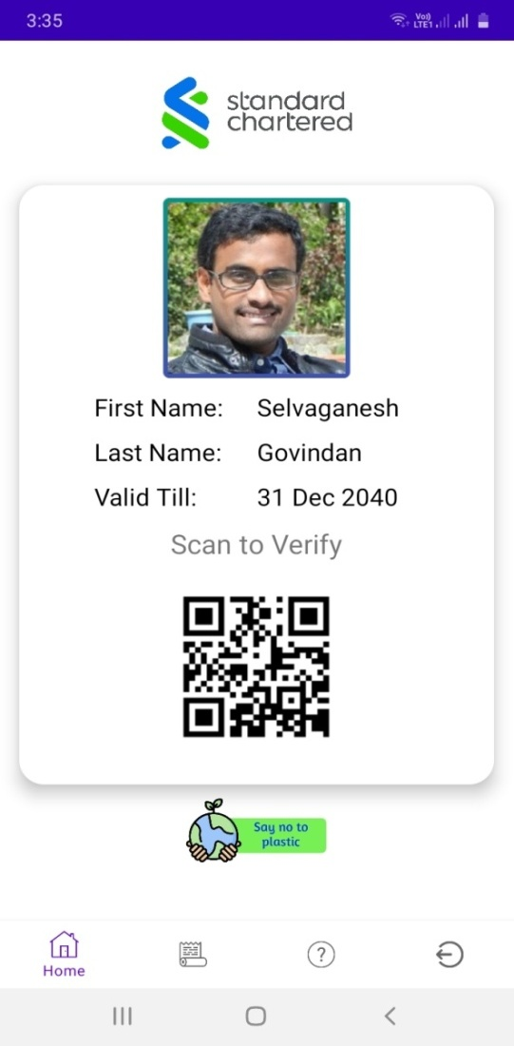
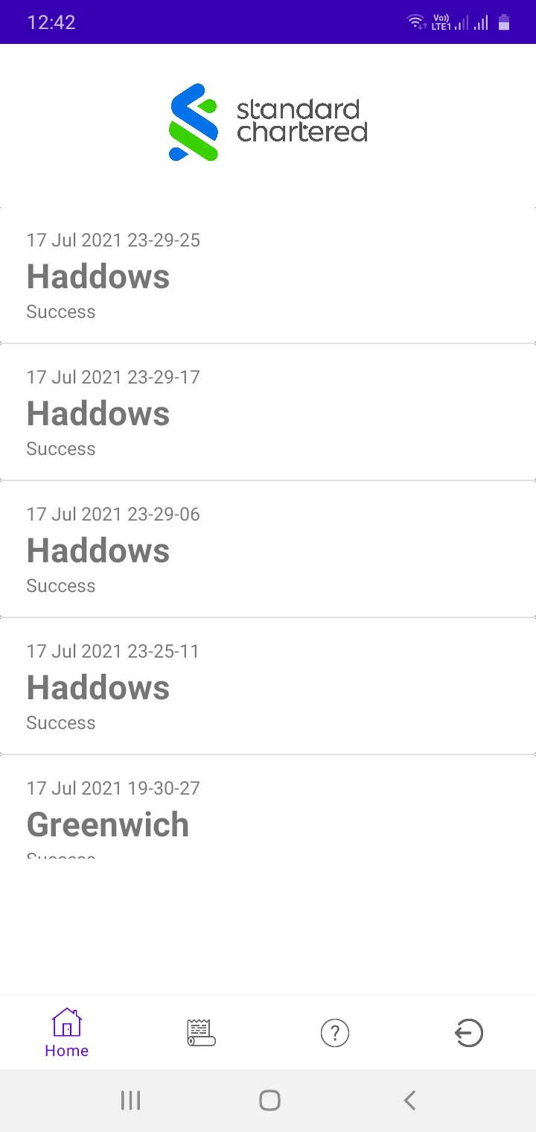
Digital ID card app
Login Module with bank id login for employees and external authentication for visitors
Digital ID card view with QR code generated based on secret key which expires in 30 seconds
History view with Location and timestamp

Slide 6
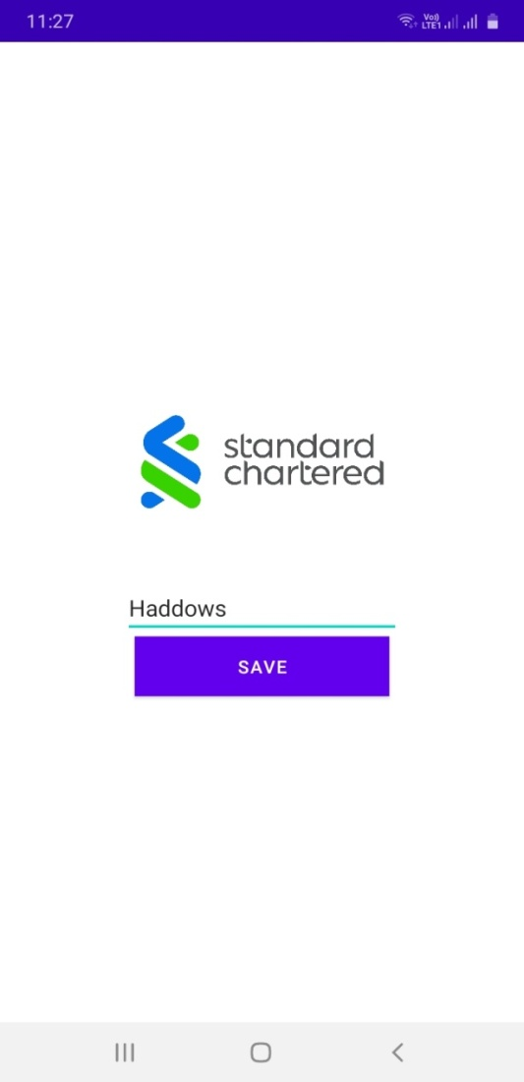
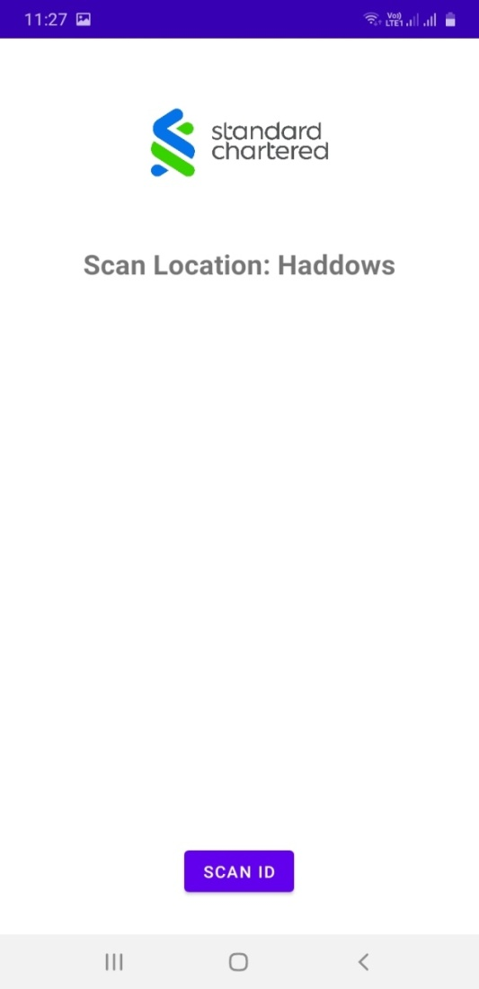
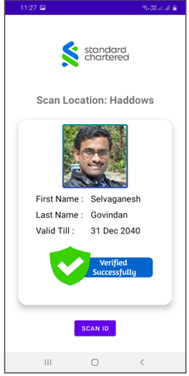
Scanner App
Scan location to be entered for capturing the location
Scan location shown for reference and initiate QR Scanner
Successful scan is shown with a representative view and verification visual cue

Slide 7
Future Enhancements
Coupling the Digital ID application with the SCB active directory for a seamless login experience for SCB employees
Integration with Bank visitor approval mechanism
Integration with ForgeRock MFA for additional security
iOS App and BYOD integration.
Provision for part-time/support staff and vehicle parking
Temperature & SpO2 level check

Slide 8
Thank You!!

